Slide 1
Next Word Auto-Completion
Kyu Cho

Slide 2
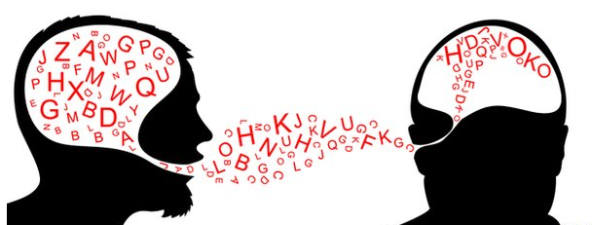
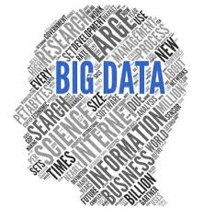

Why are language technologies needed?
A hallmark of human intelligence.
Text is the largest repository of human knowledge and is growing quickly. We are living in Big Data era!!
emails, news articles, web pages, scientific articles, insurance claims, customer complaint letters, transcripts of phone calls, technical documents, government documents, patent portfolios, court decisions, contracts, ……
Easy money if many companies could use computer programmes that understood text or speech in enormous amount of data quickly and accurately.

Slide 3
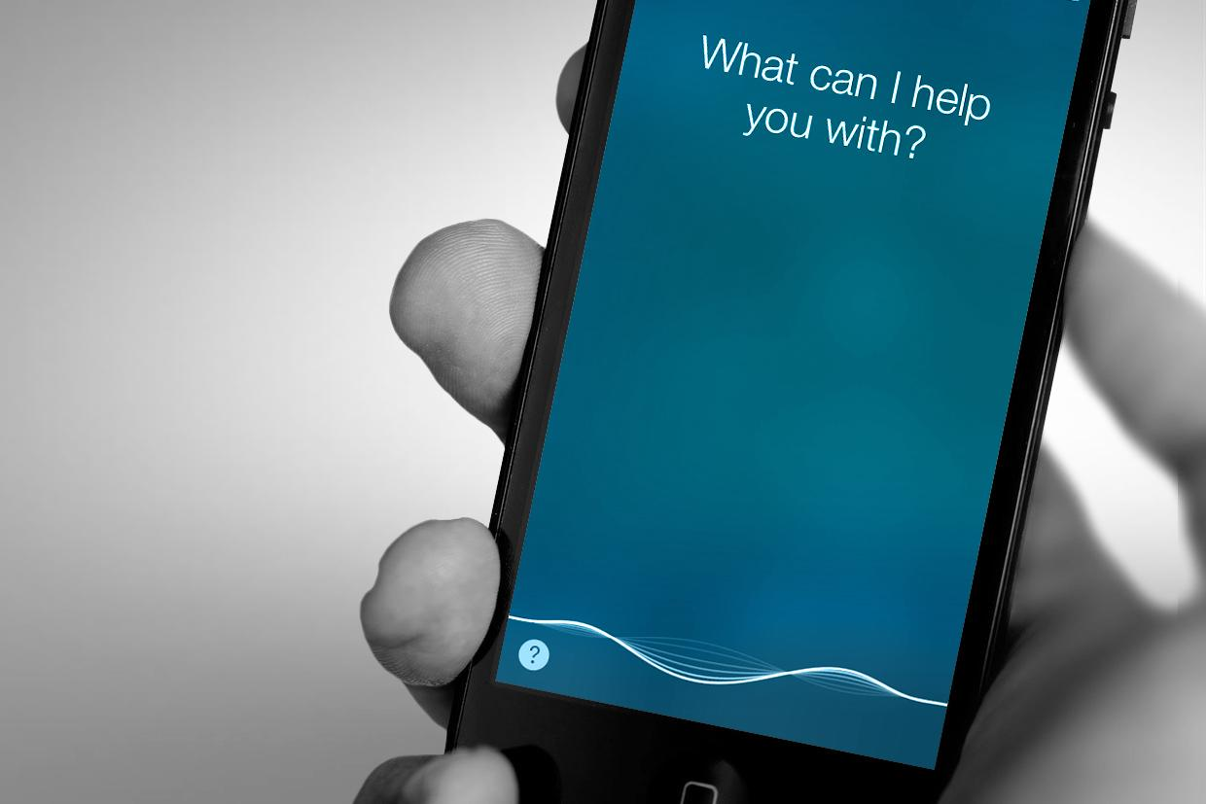
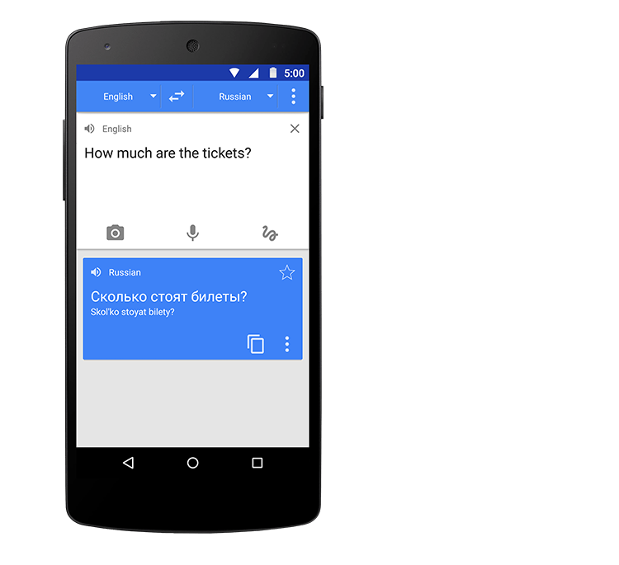
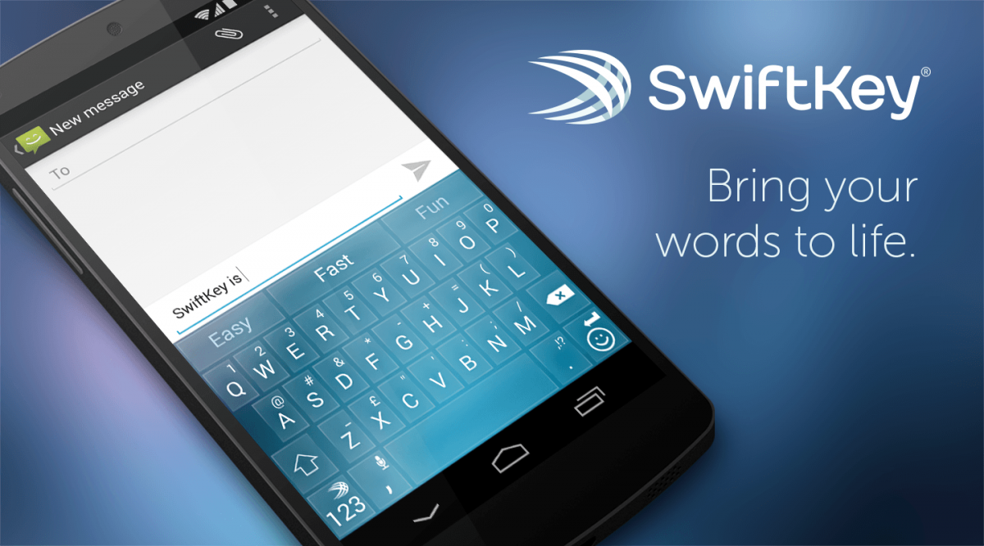
Natural Language Process (NLP) in smartphone
Language Translation
Sentiment Analysis
Voice Recognition
Question Answering
Text Prediction
Word Completion
Spelling Correction
Authorship Identification

Slide 4
App
https://kyucho.shinyapps.io/nextword/

Slide 5
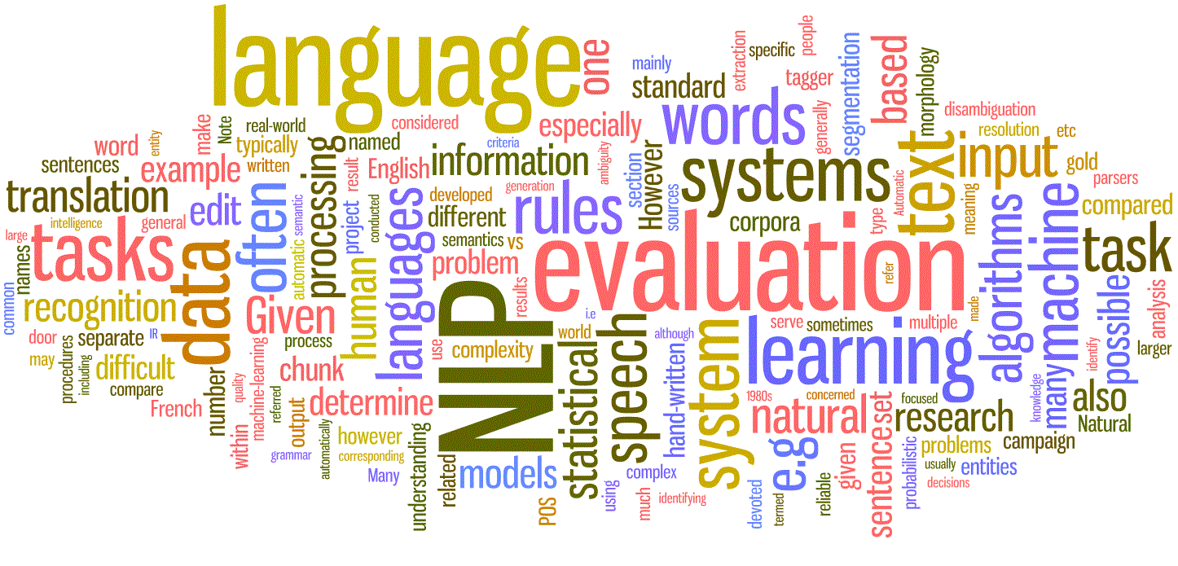
Human Word Prediction
Clearly, at least some of us have the ability to predict future words in an utterance.
How?
Domain knowledge
Syntactic knowledge
Lexical knowledge

Slide 6
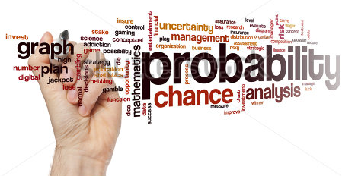
Machine Word Prediction
A useful part of the knowledge needed to allow Word Prediction can be captured using simple statistical techniques
The probability of a sequence of letters and words.

Slide 7
Computing the Probability of a Word Sequence
Try: Computing the product of component conditional probabilities?
P(I want to eat Italian food) = P(I) * P(want | I ) * P(to | I want)
* P(eat | I want to) * P(Italian | I want to eat)
* P(food | I want to eat Italian)
Problem: The longer the sequence, the less likely we are to find it in a training data set.
P(Most biologists and folklore specialists believe that in fact the mythical unicorn horns derived from the narwhal)
Solution: Maximum Likelihood Estimation(MLE) using N-grams

Slide 8
Maximum Likelihood Estimation (MLE) with N-grams
Markov Assumption:
The Probability of a word depends only on the probability of a limited history.
Generalization:
The probability of a word depends only on the probability of the
N-previous words.
bi-gram, tri-grams, quad-grams,…

Slide 9
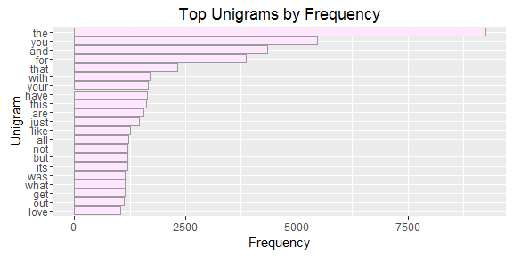
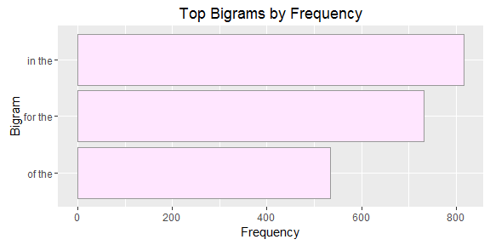
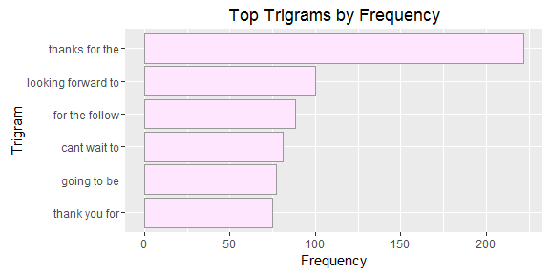
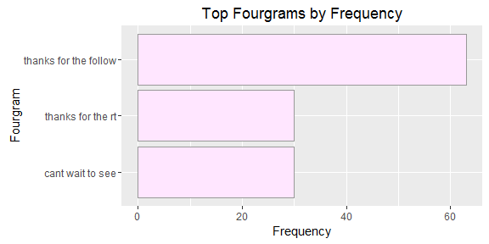
Plot

Slide 10

N-grams Examples
N-gram formula
$P(w_{n}|w_{1}^{n−1})$ $≈$ $P\left(w_{n} | w_{n−N−1}^{n−1}\right)$
Probability with Brute Force
P(I want to eat Italian food) = P(I) * P(want | I ) * P(to | I want)
* P(eat | I want to) * P(Italian | I want to eat)
* P(food | I want to eat Italian)
Probability of Bi-gram
P(I want to eat Italian food) = P(food | Italian)
Probability of Tri-gram
P(I want to eat Italian food) = P(food | Italian) * P(food | eat Italian)
Probability of Quad-gram
P(I want to eat Italian food) =
P(food | Italian) * P(food | eat Italian) * P(food | to eat Italian)

Slide 11
Training and Testing
Overly narrow corpus: probabilities don't generalize
Ex) brute force
Overly general corpus: probabilities don't reflect task or domain
Ex) Uni-gram, bi-gram

Slide 12
Backoff
The higher N-gram needs more data to train.
Thus backoff models is needed for missing value.
Stupid-backoff – simple yet powerful
If the quad-gram has no match in the data set, move to tri-gram
If the tri-gram has no match in the data set, move to bi-gram. Etc
“want to eat” in quad-gram data set? No then
“to eat” in tri-gram data set? No then
“eat” in bi-gram data set? yes then
what’s the predicted word after “eat”?

Slide 13
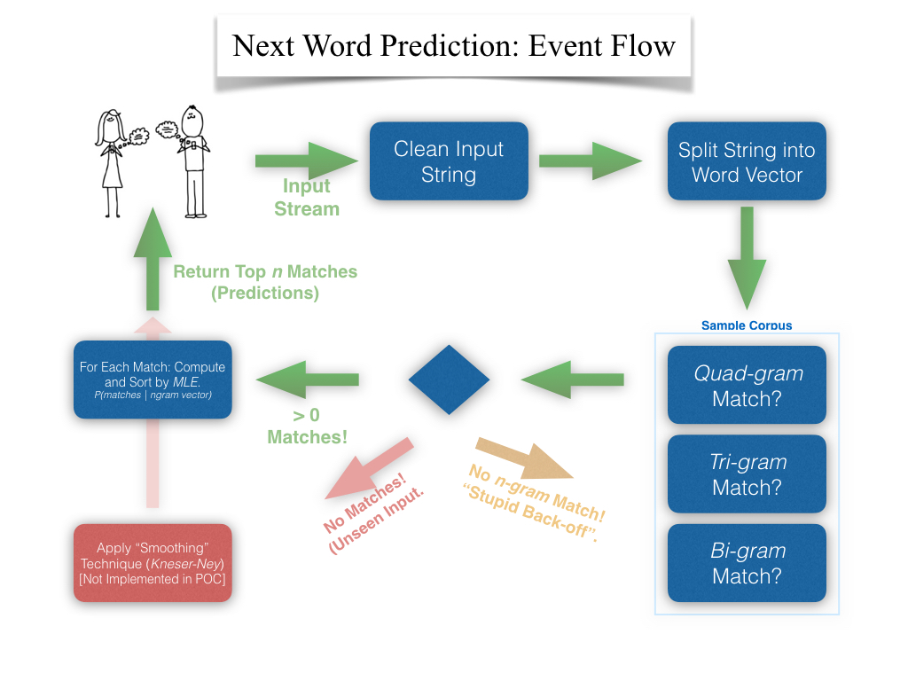
Flow Chart

Slide 14
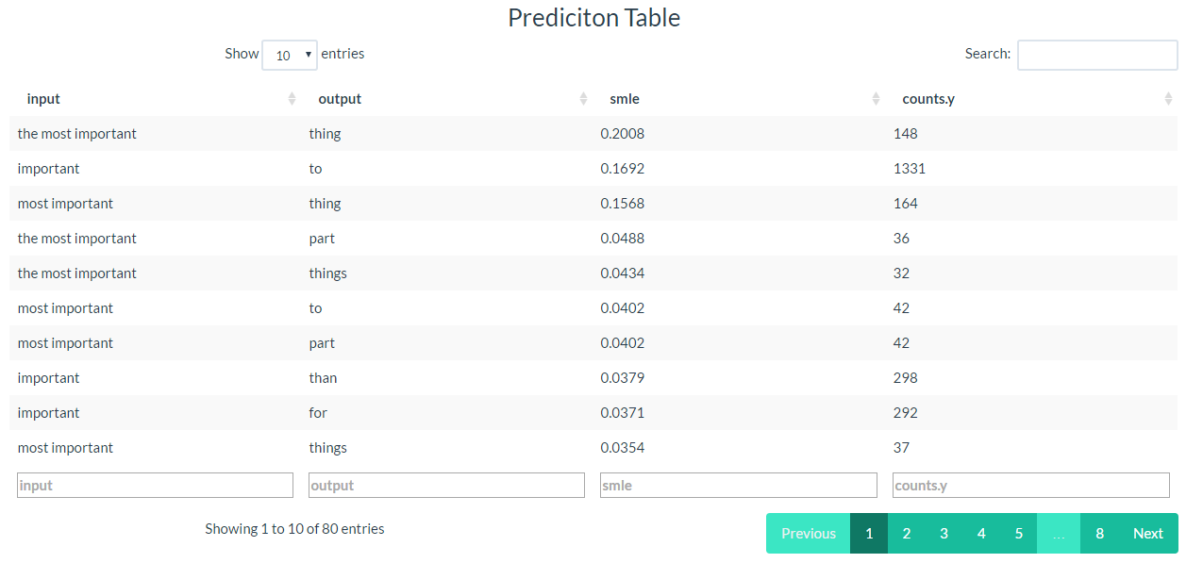
Table

Slide 15
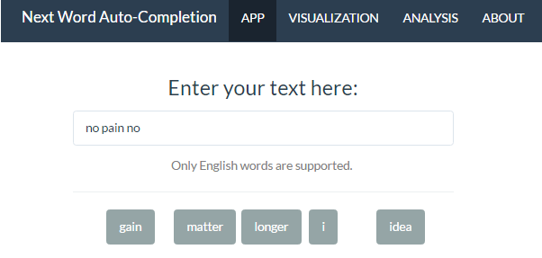
What have I done for past few months?
Collect data from twitter API (0.5 GB Data)
Clean data
remove bad words and symbols,
won’t -> will not, etc
Create N-gram up to 4
Calculate Maximum Likelihood Estimation
Data Explanatory Analysis
Build the Model based on
the N-gram data set with MLE
Develop Front-end and Back-end for UI

Slide 16
THANK YOU
App
https://kyucho.shinyapps.io/nextword/
Source
https://github.com/jamin567/DataScienceCapston
Inquiry
chok20734@gmail.com

